Slide 1
Banking Management System

Slide 2
This project is completed By :
AARIFA
ANJILA CHOUDHARY

Slide 3
AGENDA
1.Introduction
2. Features
3.Entity
4. Relationship
5. Benefits
6. Output

Slide 4
Introduction
A Bank Management System is a software platform or application designed to help banks and financial institutions efficiently manage their operations.
It typically includes various features such as customer relationship management, account management, transaction tracking, loan management, and security measures.

Slide 5
Requirements:
Language Programming language used for the projects is : JAVA | Framework Framework used in this project is Hibernate. It is an Object relational mapping Framework for java. | Environment IntelliJ IDEA is a integrated development environment primarily used for the project

Slide 6
Continued ….
Bank and Customer:
A bank serves multiple customers, and each customer may have accounts and transactions with the bank. This is a many-to-many relationship, where one bank entity can be associated with many customer entities, and vice versa.
Customer and Account:
A customer can have multiple accounts with the bank, such as savings, checking, and investment accounts. Each account belongs to one customer. This is a one-to-many relationship, where one customer entity can be associated with many account entities.

Slide 7
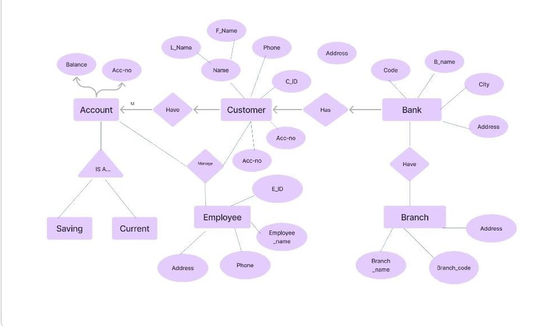
ER Diagram :

Slide 8
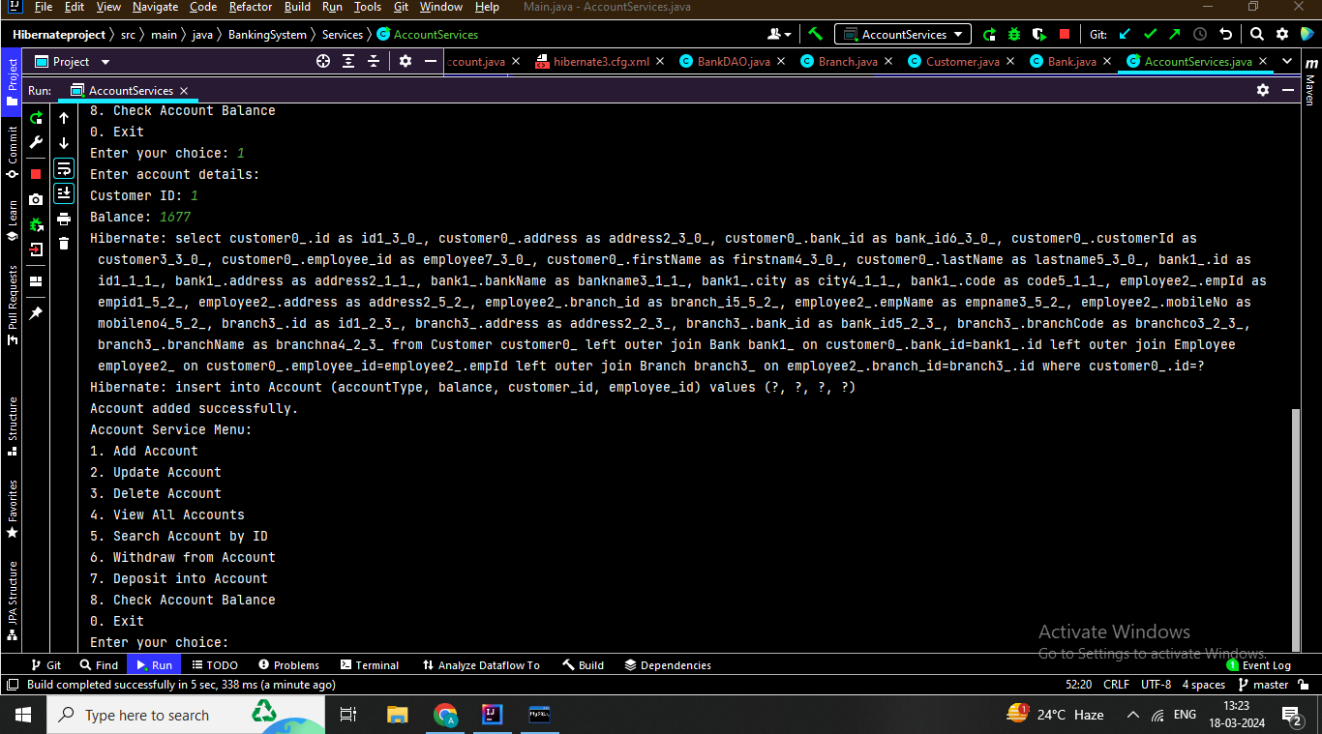
OUTPUT

Slide 9
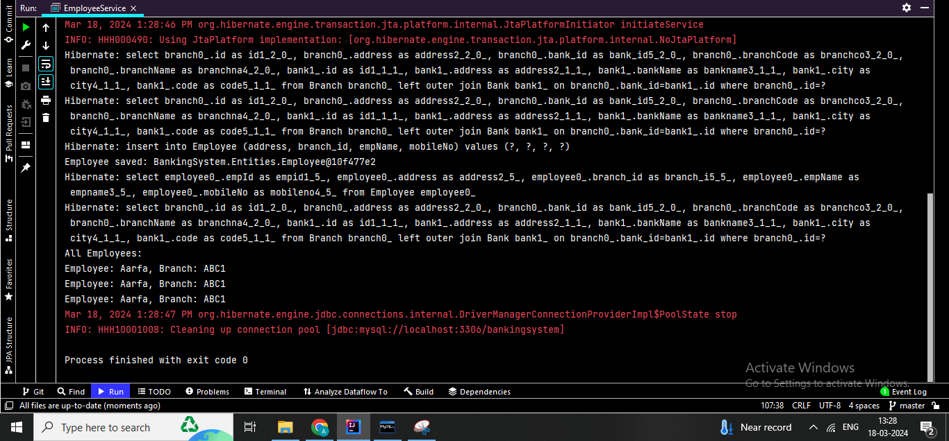

Slide 10
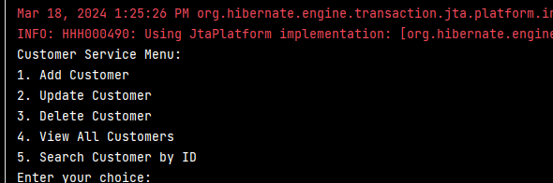

Slide 11
Thank You

